Slide 1
XGBoost Algorithm
XGBoost = eXtreme Gradient Boosting
A powerful, fast, and scalable machine learning algorithm
Works well for regression, classification, ranking

Slide 2
How it works?
Start with initial prediction (mean value)
Fit a small decision tree to the residuals
Add that tree’s prediction to the final output
Repeat multiple times to reduce error
Uses gradient descent + regularization

Slide 3
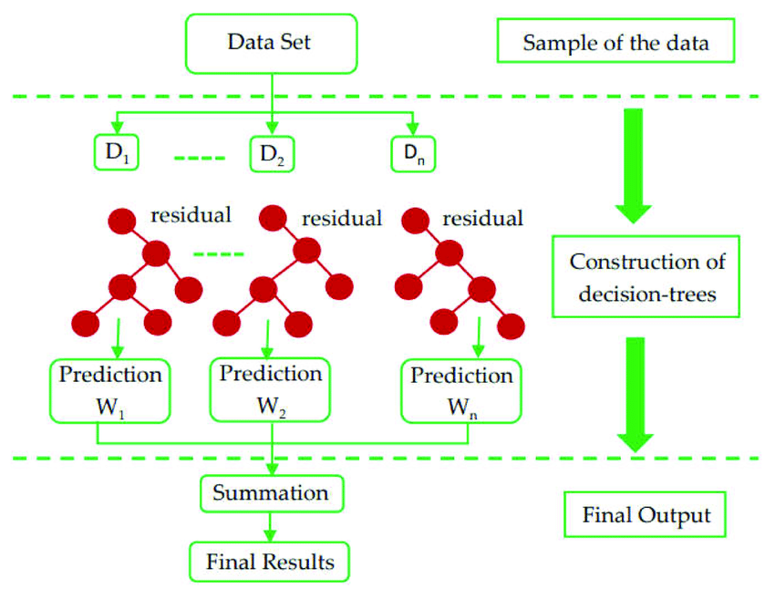

Slide 4
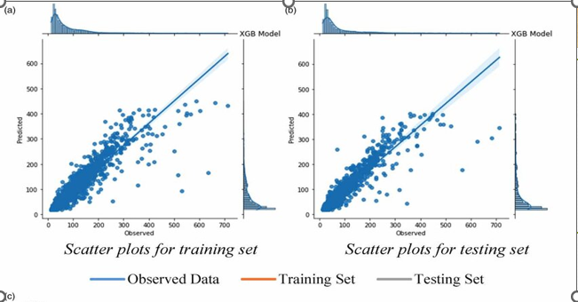

Slide 5
Why Use XGBoost?
Fast and efficient
Very high accuracy
Handles non-linear data
Deals with missing values
Avoids overfitting with regularization

Slide 6
Advantages of XGBoost
High Performance and Accuracy
Regularization to Prevent Overfitting
Fast and Efficient
Handles Missing Values Automatically
Supports Early Stopping
Scales to large datasets
Works for classification andregression

